Slide 1
Academic Vacation and Sick Leave Maintenance Instructions
University and System Human Resources
Fall 2025

Slide 2
When should I work on this?
University of Illinois System requires viewing and updating academic employee leave information between August 16, 2024, and August 15, 2025, for the fall reporting period.
It is critical that units complete the leave reporting no sooner than August 16, 2025, and no later than September 6, 2025, for all academic employees.
Go to the HR Reporting Portal to access a report of employee leave balances for those that you need to report usage in your organization. (https://hrreportingportal.uillinois.edu/Reports/)

Slide 3
Reporting Usage for Exempt Employees
Academic employees who are not eligible for overtime should be reporting absences in half- and full-day increments only (except when leave is taken under the Family and Medical Leave Act).
Absences in increments less than half- or full-days should not be charged (applied against leave “taken”) against vacation or sick leave balances, unless FMLA.
Full-time Academic employees are paid on an 8-hour day.
Part-time and alternative schedule employees report absences as appropriate based on their schedule. Generally speaking, the employee reports either half-day or a full-day based on their scheduled hours for the day.

Slide 4
After collecting the employee’s leave “taken”, you will use Banner
An on-line calculator is available on the System HR website which will assist you in verifying accruals needed for Fall 2025 reporting https://www.hr.uillinois.edu/cms/One.aspx?portalId=4292&pageId=5601
Banner – leave balance, accrual and taken information is found on the PEALEAV form

Slide 5
Step 1—View Employee Leave Balance Information in Banner
From main Banner menu, type PEALEAV, press Enter
Type the employee UIN, Next Block
View Employee Leave Balance summary screen (shown below)
Shows taken from 8/16/24-8/15/25 – will be zero if unit has not yet entered leave taken
Accrual from 8/16/24- 8/15/25
Current Available
As of 8/16/24
Floating Holidays are not maintained in Banner for academic employees, they need to be maintained in the unit
No changes are made on this screen (made in the next block of PEALEAV, covered on slide 7)
If there are multiple leave eligible jobs, this is the total leave information for all jobs

Slide 6
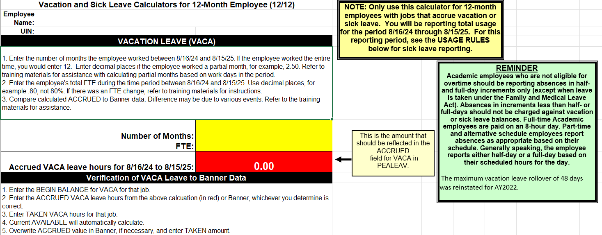
Step 2—Use the Excel Calculator to compute accruals and verify balance information
With the on-line calculator you will be able to easily calculate accruals and verify Banner PEALEAV information. The calculator shown to the left is for a 12-month employee. There are separate calculators available for 9-month and 12-month employees.
You may save calculations for an individual.
To download the Excel calculator to your desktop, select File, Save As, in your web browser menu bar. You may then save the calculator to your desktop / personal folder.
Link to on-line calculators: https://www.hr.uillinois.edu/cms/One.aspx?portalId=4292&pageId=5601

Slide 7
Step 3: View and/or Edit Job Leave Balances
From the Employee summary screen, Next Block. View Job Leave Balances is the next screen.
Click on the job number to be viewed or maintained.
Use scroll bar to access appropriate leave code.
If Begin Balance or Accrued are not correct, click on the field to be edited and overwrite with the correct number. Accrued is total from 8/16/24 through 08/15/25.
In the Taken field, enter the total hours taken from 8/16/24 through 08/15/25.
Override the Date Available field with 08/15/25.
Enter Change Reason “Maintaining leave balances through 08/15/25”.
Save.
Donations to the Shared Benefits Pool should be included in the amount reported as Taken by that individual in the SICK or VACA leave category. At UIC, this has already been entered by university HR. If an employee was a recipient of leave from the Shared Benefits Pool:
hours received should be shown in the Beginning Balance field of SHBN (entered by university HR),
taken should be reported in the Taken field of SHBN.

Slide 8
Step 4—Verify Employee Leave Balance Information after Editing Job Information
From the Job Leave Balances screen, Rollback to return to the summary screen
Next Block to view the Leave Balance Totals and verify your changes
Beginning Balance for 8/16/24
Total Accrued to date for the academic year 8/16/24 to 8/15/25
Total Taken for the academic year 8/16/24 to 8/15/25
Current Available
If there are multiple leave-eligible jobs, this is the total information for all jobs.

Slide 9
Reporting for 9 Month Employees
Between 8/16/24 and 5/15/25, 9-month employees accrue all of their leave and use any leave. As a result, reporting that was done in May for 9-month employees completes leave maintenance for the year.

Slide 10
Reporting for 12 Month Employees
Between 8/16/24 and 8/15/25, 12-month employees accrue all of their leave for the academic year.
According to the rules below, you may need to make adjustments to the TAKEN field in SICK.
According to policy, sick leave is used in this order:
first use cumulative SICK Accrual from this academic year (96 hours/12 days),
then non-cumulative SICN Accrual (104.04 hours/13 days),
and finally, Begin Balance in SICK
NOTE: hours accrued above reflect an employee who is appointed full-time for a full academic year.

Slide 11
Example of SICK and SICN usage for 12 month employee
A full time 12-month employee had a beginning balance of 100 hours of cumulative sick leave (SICK) and accrued all of their sick leave and reports all used sick leave for the period 8/16/24 to 8/15/25.
The employee accrued 96 hours (12 days) of cumulative sick leave and 104.04 hours (13 days) of non-cumulative sick leave (SICN).
The employee reported to the unit that they had used 240 hours of sick leave.
 | Beginning Balance | Accrued | Current Available
SICK | 100 | 96 | 196
SICN | 0 | 104.04 | 104.04
Total sick leave used = 240 hours

Slide 12
Example of SICK and SICN usage for 12 month employee, cont.
First use current year SICK Accrual (96 hours/12 days) | 96 hours
Then current year SICN Accrual (104.04 hours/13 days) | 104.04 hours
And finally, use part of the balance from SICK | 39.96 hours
Total used | 240 hours
How to report this sick leave in Banner:
SICK Taken (96 + 39.96) | 135.96
SICN Taken | 104.04
Total Taken reported | 240

Slide 13
How do I report when the employee has more than one leave eligible job?
Report all taken amounts on Primary job
This may result in a negative Current Available on that job. When you review the Summary information you should see the accurate total employee information.
Note:
The Annual Vacation and Sick Leave Roll performed within the MN9 pay period places the total Beginning Balance for the employee on the Primary Job
You will want to verify that accruals occurred correctly for all job(s) at that time.

Slide 14
What transactions may affect leave balances and accruals?
Pay adjustments
Employee Class change
Leaves of Absence

Slide 15
Leave maintenance needed due to pay adjustments
If your employee had a pay adjustment for regular pay (i.e. missed the deadline for calc for a new hire), leave accruals will not have occurred. Units can use the Pay History Leave Accruals form (PHIACCR) to verify whether or not the leave accrual occurred for a particular pay period.
You will need to use the On-line Excel Calculator to determine the total accrual and then you will overwrite the Accrued in Banner.
Enter the number of months the person worked in the job – for a partial month use days worked/work days (See Payroll Schedule for official work days in each month)
Enter the employee’s total FTE for those months
The accrual to be entered into PEALEAV will be calculated for you.

Slide 16
Leave maintenance needed due to employee class change
If an employee moves from one employee class to another, the leave information needs to be verified for accuracy.
Example: Your employee moved from Civil Service (with a balance of 200 hours on a 37.5-hour workweek) to Academic Professional. As a part of that move, the balances would have been converted to days and then the new beginning balance in hours based on an 8-hour work day. In this example, 200/7.5x8=213. The new beginning balance should be 213 hours of leave.
University/Campus HR will have
ensured the final balances for vacation and sick leave were correct for the Civil Service job
zeroed out the Civil Service information
converted final balances to new workweek if necessary
entered current available as the Beginning Balance for the academic job for all eligible leave codes

Slide 17
Leave maintenance needed due to Leave of Absence
To verify accruals are correct, the Leave Balance History (PEILHIS) form or the Pay History Leave Accruals form (PHIACCR) can be used to see if accruals have occurred correctly during the time period of the leave. If accruals have incorrectly occurred, adjustments to Accrued are necessary.
Unpaid Leave (should not accrue any leave benefits)
Partial Paid Leave (should only accrue leave benefits for the appointment percentage they are being paid)
Excel Calculator can be used to determine what should have accrued. For example, a) determine # of months on full accruals, b) determine # of months with no accrual or partial accrual, c) add together for total correct accrual
Overwrite with the correct accrual amount in the Accrued field.

Slide 18
Important notes on maintaining leave balances
Do not access or maintain balances when the payroll calc is being performed.
Payroll “calc” begins at 5pm on the published date and is finished when the pay disposition is at 70. (Pay dispositions can be viewed on PZILIST.)
Leave reporting needs to be completed no later than September 6, 2025!!
REMINDER: The maximum vacation leave rollover of 48 days was reinstated for AY2022.

Slide 19
University and System Human Resource Services Contact Information
https://www.hr.uillinois.edu/contacts

